Slide 1
Cornerstone City Church Peninsula Plus Community Hoo Are Ya
6th October 2024

Slide 2


Slide 3


Slide 4
He's Got The Whole World In His Hands
CCLI Song # 33681
© Words: Public Domain; Music: Public Domain
For use solely with the SongSelect® Terms of Use. All rights reserved. www.ccli.com
CCLI License # 33265

Slide 5
1/7
He's got the whole world in His hands
He's got the whole world in His hands
He's got the whole world in His hands
He's got the whole world in His hands

Slide 6
2/7
He's got the little tiny baby in His hands
He's got the little tiny baby in His hands
He's got the little tiny baby in His hands
He's got the whole world in His hands

Slide 7
3/7
He's got you and me brother in His hands
He's got you and me brother in His hands
He's got you and me brother in His hands
He's got the whole world in His hands

Slide 8
4/7
He's got you and me sister in His hands
He's got you and me sister in His hands
He's got you and me sister in His hands
He's got the whole world in His hands

Slide 9
5/7
He's got ev'rybody here in His hands
He's got ev'rybody here in His hands
He's got ev'rybody here in His hands
He's got the whole world in His hands

Slide 10
6/7
He's got the wind and the rain in His hands
He's got the wind and the rain in His hands
He's got the wind and the rain in His hands
He's got the whole world in His hands

Slide 11
7/7
He's got the sun and the moon in His hands
He's got the sun and the moon in His hands
He's got the sun and the moon in His hands
He's got the whole world in His hands

Slide 12
Praise
CCLI Song # 7213077
© Brandon Lake MusicFor Humans PublishingMaverick City PublishingCapitol CMG GenesisCapitol CMG ParagonHousefires SoundsWriter's Roof PublishingMusic by Elevation Worship Publishing
For use solely with the SongSelect® Terms of Use. All rights reserved. www.ccli.com
Note: Reproduction of this sheet music requires a CCLI Music Reproduction Licence. Please report all copies.
CCLI Licence No. 33265

Slide 13
1/12
Let everything that has breath
Praise the Lord
Praise the Lord

Slide 14
2/12
I’ll praise in the valley
Praise on the mountain
I’ll praise when I’m sure
Praise when I’m doubting

Slide 15
3/12
I’ll praise when outnumbered
Praise when surrounded
'Cause praise is the water
My enemies drown in

Slide 16
4/12
As long as I’m breathing
I’ve got a reason to Praise the Lord oh my soul
Praise the Lord oh my soul

Slide 17
5/12
I’ll praise when I feel it
And I’ll praise when I don’t
I’ll praise 'cause I know
You’re still in control

Slide 18
6/12
'Cause my praise is a weapon
It’s more than a sound
My praise is the shout
That brings Jericho down

Slide 19
7/12
As long as I’m breathing
I’ve got a reason to Praise the Lord oh my soul
Praise the Lord oh my soul

Slide 20
8/12
I won’t be quiet
My God is alive
How could I keep it inside
Praise the Lord oh my soul

Slide 21
9/12
I’ll praise 'cause You’re sovereign
Praise 'cause You reign
Praise 'cause You rose and defeated the grave
I’ll praise 'cause You’re faithful
Praise 'cause You’re true
Praise 'cause there’s nobody greater than You

Slide 22
10/12
Praise the Lord oh my soul
Praise the Lord oh my soul
Praise the Lord oh my soul
Praise the Lord oh my soul
I won’t be quiet
My God is alive
How could I keep it inside

Slide 23
1 1/12
I won’t be quiet
My God is alive
How could I keep it inside
I won’t be quiet
My God is alive
How could I keep it inside
Praise the Lord oh my soul

Slide 24
12/12
Let everything that has breath
Praise the Lord
Praise the Lord

Slide 25
House Of The Lord
CCLI Song # 7168995
© 2020 Phil Wickham MusicSimply Global SongsBe Essential SongsCashagamble Jet Music
For use solely with the SongSelect® Terms of Use. All rights reserved. www.ccli.com
Note: Reproduction of this sheet music requires a CCLI Music Reproduction Licence. Please report all copies.
CCLI Licence No. 33265

Slide 26
1/9
We worship the God who was
We worship the God who is
We worship the God who evermore will be
He opened the prison doors
He parted the raging sea
My God He holds the victory yeah

Slide 27
2/9
There’s joy in the house of the Lord
There’s joy in the house of the Lord today
And we won’t be quiet
We shout out Your praise

Slide 28
3/9
There’s joy in the house of the Lord
Our God is surely in this place
And we won’t be quiet
We shout out Your praise

Slide 29
4/9
We sing to the God who heals
We sing to the God who saves
We sing to the God who always makes a way
'Cause He hung up on that cross
Then He rose up from that grave
My God’s still rolling stones away

Slide 30
5/9
There’s joy in the house of the Lord
There’s joy in the house of the Lord today
And we won’t be quiet
We shout out Your praise

Slide 31
6/9
There’s joy in the house of the Lord
Our God is surely in this place
And we won’t be quiet
We shout out Your praise

Slide 32
7/9
We were the beggars
Now we’re royalty
We were the prisoners
Now we’re running free
We are forgiven accepted
Redeemed by His grace
Let the house of the Lord sing praise
(REPEAT)

Slide 33
8/9
There’s joy in the house of the Lord
There’s joy in the house of the Lord today
And we won’t be quiet
We shout out Your praise

Slide 34
9/9
There’s joy in the house of the Lord
Our God is surely in this place
And we won’t be quiet
We shout out Your praise

Slide 36
Heart Of Worship CCLI Song # 2296522
Matt Redman
© 1997 Thankyou Music (Admin. by Integrity Music Ltd)
For use solely with the SongSelect® Terms of Use. All rights reserved. www.ccli.com
CCLI Licence No. 33265

Slide 37
1/6
When the music fades all is stripped away
And I simply come
Longing just to bring something that's of worth
That will bless Your heart

Slide 38
2/6
I'll bring You more than a song
For a song in itself is not what You have required
You search much deeper within
Through the way things appear
You're looking into my heart

Slide 39
3/6
I'm coming back to the heart of worship
And it's all about You all about You Jesus
I'm sorry Lord for the thing I've made it
When it's all about You all about You Jesus

Slide 40
4/6
King of endless worth no one could express
How much You deserve
Though I'm weak and poor all I have is Yours
Ev'ry single breath

Slide 41
5/6
I'll bring You more than a song
For a song in itself is not what You have required
You search much deeper within
Through the way things appear
You're looking into my heart

Slide 42
6/6
I'm coming back to the heart of worship
And it's all about You all about You Jesus
I'm sorry Lord for the thing I've made it
When it's all about You all about You Jesus

Slide 43
1/1
From my heart to the heavens Jesus be the center
It's all about You yes it's all about You
From my heart to the heavens Jesus be the center
It's all about You yes it's all about You (Jesus)
(REPEAT)

Slide 45
Worthy Of it All
CCLI Song # 6280644
David Brymer | Ryan Hall
© 2012 Common Hymnal Publishing (Admin. by Integrity Music Ltd)
Innerland (Admin. by Integrity Music Ltd)
Underground Treasure (Admin. by Integrity Music Ltd)
Wayfinder Music (Admin. by Integrity Music Ltd)
For use solely with the SongSelect® Terms of Use. All rights reserved. www.ccli.com
CCLI Licence No. 33265

Slide 46
1/3
All the saints and angels
Bow before Your throne
All the elders cast their crowns
Before the Lamb of God and sing

Slide 47
2/3
You are worthy of it all
You are worthy of it all
For from You are all things
And to You are all things
You deserve the glory

Slide 48
3/3
Day and night,
Night and day,
Let incense arise
(X4)
Day and night
Night and day

Slide 49
1/1
So here I am to worship
Here I am to bow down
Here I am to say that You're my God
And You're altogether lovely
Altogether worthy
Altogether wonderful to me

Slide 50


Slide 52


Slide 53
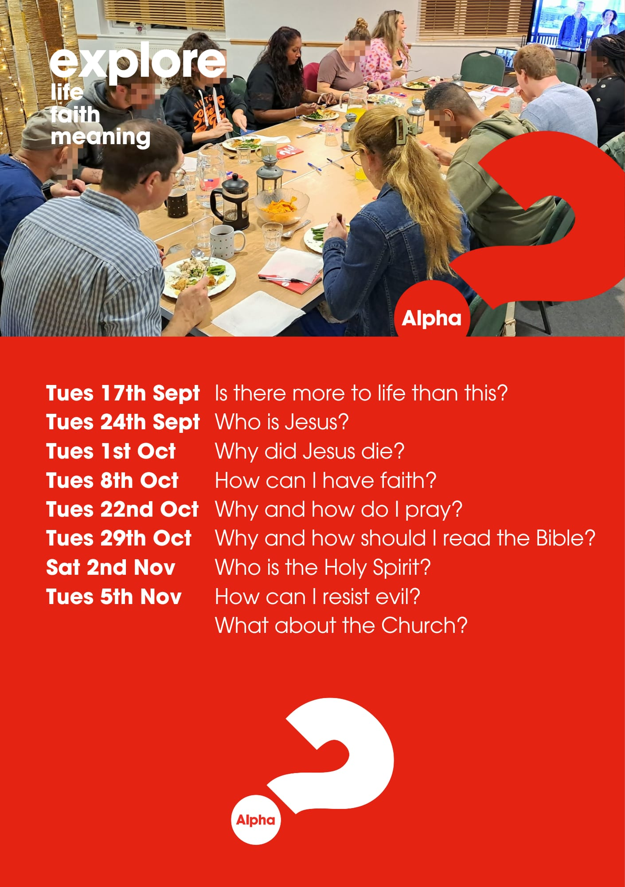

Slide 54


Slide 55


Slide 56
Trust In God
CCLI Song # 7206001
Brandon Lake | Chris Brown | Mitch Wong | Steven Furtick
© Brandon Lake Music; Music by Elevation Worship Publishing; A Wong Made Write Publishing; Integrity's Praise! Music
For use solely with the SongSelect® Terms of Use. All rights reserved. www.ccli.com
CCLI Licence No. 33265

Slide 57
1/6
Blessed assurance
Jesus is mine
He's been my fourth man in the fire
Time after time
Born of His Spirit
Washed in His blood
And what He did for me on Calvary
Is more than enough

Slide 58
2/6
I trust in God
My Savior
The One who will never fail
He will never fail

Slide 59
3/6
Perfect submission
All is at rest
I know the author of tomorrow
Has ordered my steps
So this is my story
And this is my song
I’m praising my risen King and Savior
All the day long

Slide 60
4/6
I trust in God
My Savior
The One who will never fail
He will never fail

Slide 61
5/6
I sought the Lord and He heard and He answered
I sought the Lord and He heard and He answered
I sought the Lord and He heard and He answered
That’s why I trust Him
That’s why (I trust Him)

Slide 62
6/6
I trust in God
My Savior
The One who will never fail
He will never fail

Slide 63
2 Corinthians 14 May the grace of the Lord Jesus Christ, and the love of God, and the fellowship of the Holy Spirit be with you all

